Slide 1
Predictive Coding
The Removal of redundancy from input

Slide 2
Background
Initially developed for transmission of video data 1952
Introduced to neuroscience by M. V. Srinivasan to explain inhibition in the retina
Adapted to suit hierarchical models of the visual system by Rao & Ballard in 1999, todays paper.

Slide 3
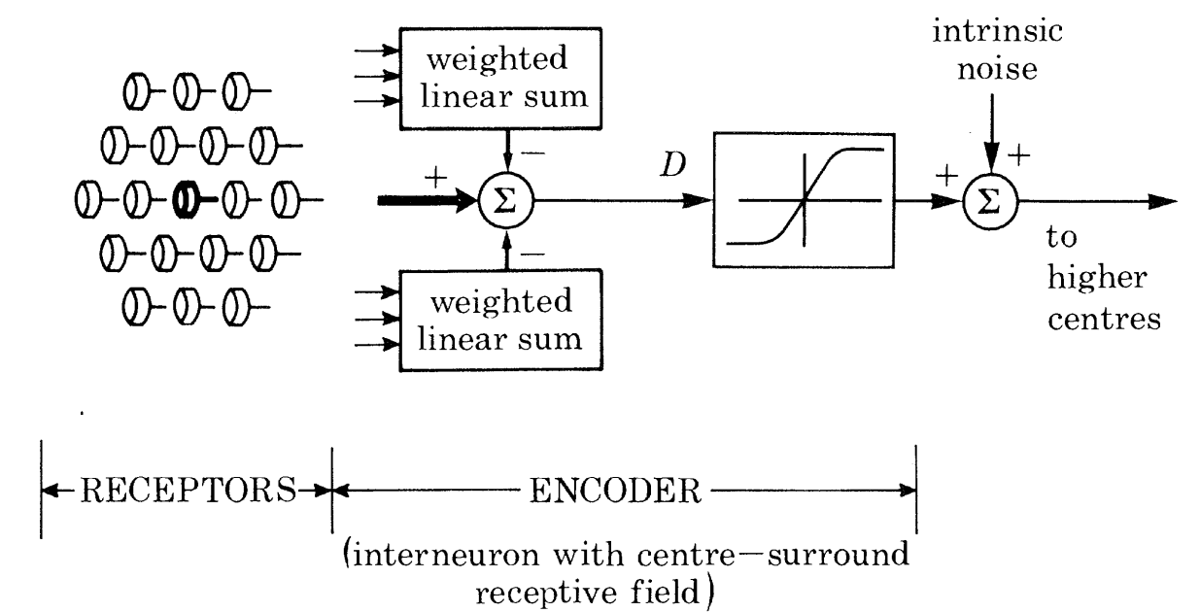
A Fresh View of Inhibition in the Retina
M. V. Srinivasan 1982
Centre-surround antagonism, [lateral inhibition]
“[suggests] the visual system is concerned with coding the visual image to protect against intrinsic noise, rather than with reconstructing the scene or extracting specific features from it.”
Why:
Removing redundancy improves encoding efficiency
Adjusts to stimulus intensity to keep neuron response ranges about the same mean
A filter for enhancing edges
Increased sensitivity to small signals, with less likelihood to lose these amidst intrinsic noise.

Slide 4
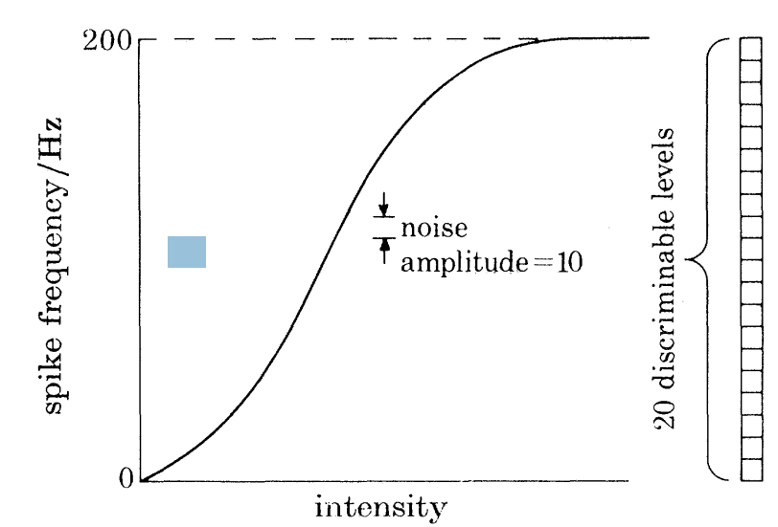
A form of Normalisation?
Neuronal output is normalised by the removal of redundant information & the adjusting to input intensity
‘A neuron can only produce a limited number of discriminable response levels’ because:
reversal potentials and maximal firing rates limit range
Intrinsic noise limits discriminability.
Srinivasan: temporal redundancy is removed by a pattern of self-inhibition. neuronal refractory periods.

Slide 5
Endstopping (end-inhibition)
Neurons that respond optimally to line segments of a particular length found in cat and monkey visual cortex
Displayed endstopping
The neuron’s response was reduced/eliminated when the line extended beyond the neuron’s receptive field.
Why should a neuron that responds to a stimulus stop responding when the same stimulus extends beyond the classical receptive field?

Slide 6
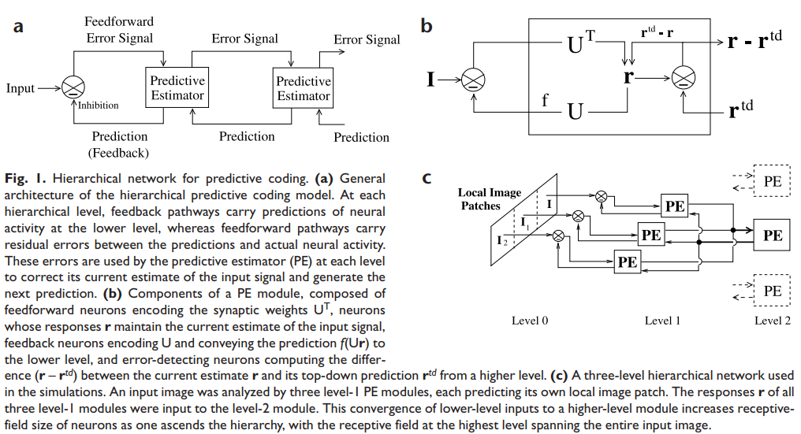


Hierarchical Predictive Coding Model

Slide 7
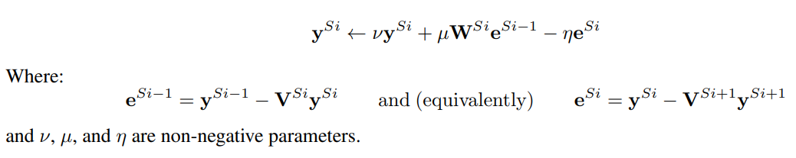
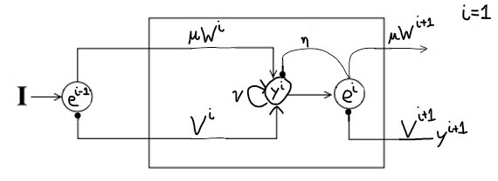
Hierarchical Predictive Coding Model

Slide 8
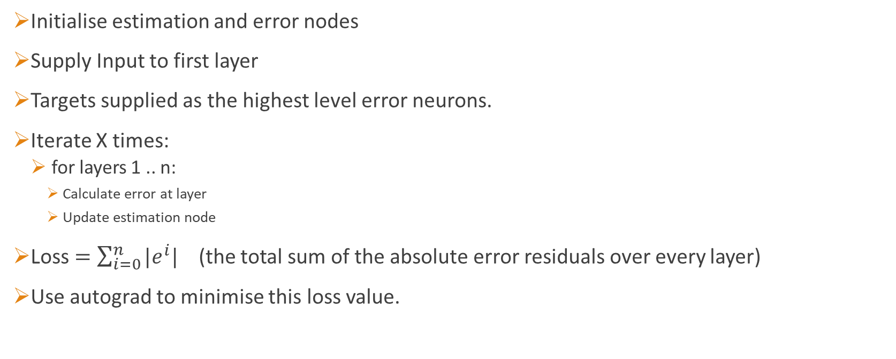
Training
Initialise estimation and error nodes
Supply Input to first layer
Targets supplied as the highest level error neurons.
Iterate X times:
for layers 1 .. n:
Calculate error at layer
Update estimation node
Loss $=\sum_{i=0}^{n}{{|e}^{i}|}$ (the total sum of the absolute error residuals over every layer)
Use autograd to minimise this loss value.

Slide 9
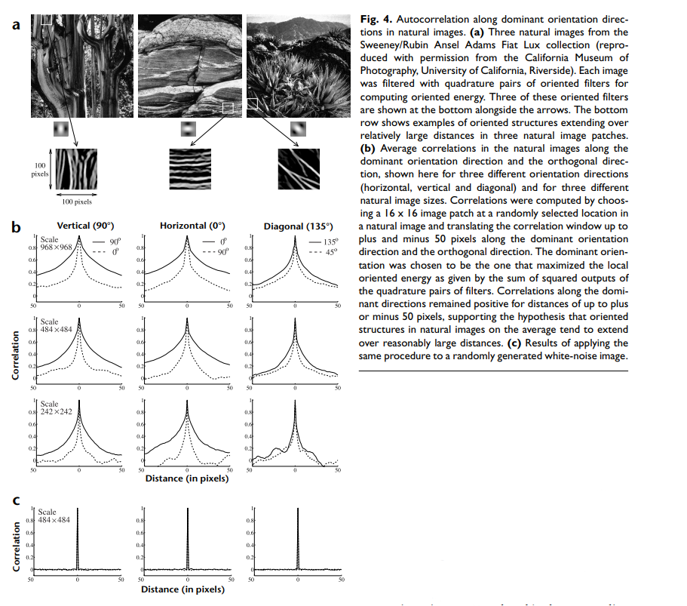
Why do neurons exhibit endstopping?

Slide 10
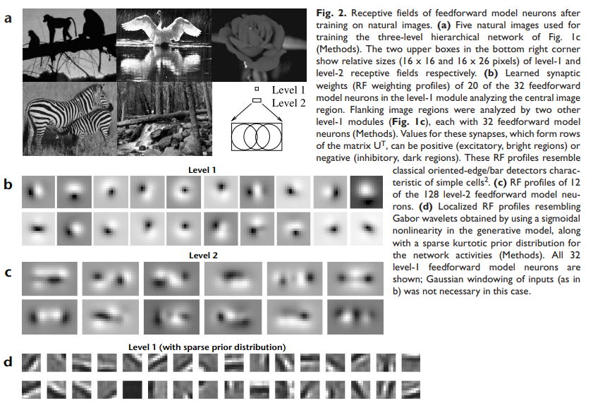







Training on Natural Images
Trained on image patches
Gaussian windowing to localise RFs in b and c
In d a different method of RF localisation is used.
Convolutional kernels can be used to impose localised receptive fields

Slide 11
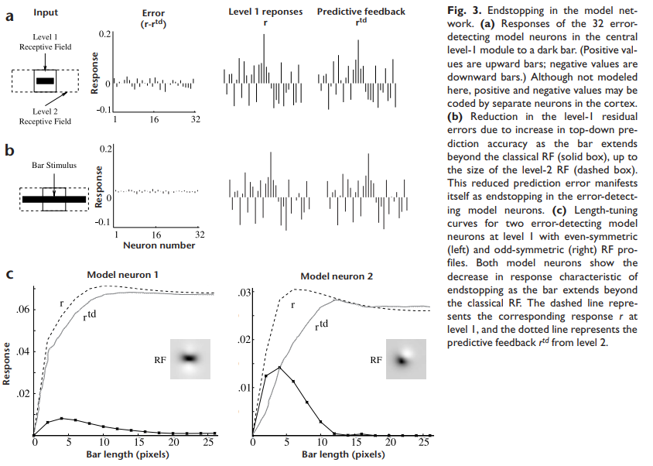


End-stopping of a model neuron
Network optimised for natural image statistics
“Without the contextual information in the surrounding region, the higher level cannot accurately predict the bar in the center.”

Slide 12
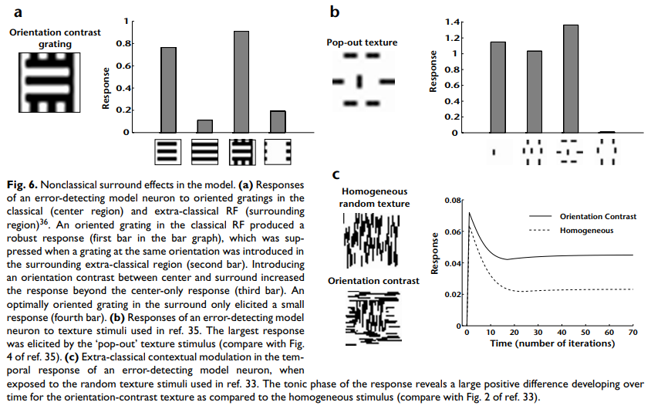
Analysis of extra-classical effects
Oriented grating produced high response in level-1 error detecting model neuron.
This steady-state response dropped 85.3% when a grating of the same orientation was introduced in the surrounding extra-classical region.
Introducing an orientation contrast increased the neuron response by 19.1%. Similar increases have been reported in primary visual cortex.
Didn’t determine whether 4th > 2nd was statistically significant.
Evidence of facilitatory effects. (bar 3 & 4)
Two distinct populations of error neurons?

Slide 13
Discussion
“The model predicts that layer 2.3 neurons will respond most vigorously to stimuli whose statistics differ in certain drastic ways from natural image statistics. This raises the interesting possibility of discovering novel extra-classical RF effects by explicitly constructing stimuli that deviate from natural image statistics.”
“In the cat, removal of feedback from visual cortical areas 17 and 18 to the LGN strongly reduces the degree of end-inhibition in LGN cells.”
“The PC model does not rule out the possibility that certain extra-classical contextual effects may result from recurrent lateral inhibition”, from within the same region.
Center-surround antagonism in MT, when direction of motion in surrounding region matches that in the center of the classical RF.
Certain neurons in the anterior inferotemporal (IT) cortex of alert behaving monkeys only fire vigorously whenever a presented test stimulus does not match the item held in memory.

Slide 14
Further work
PredNet, a network which predicts future frames in a video sequence. Built with convolutional LSTM’s in a predictive coding scheme. https://coxlab.github.io/prednet/
Spratling’s more biologically feasible ‘PC/BC-DIM’ which reformulates the scheme to make it compatible with Biased Competition theories of cortical function, and uses Divisive Input Modulation as the method for updating error and prediction neuron activations.
Karl Friston’s Free Energy Principle. Similar in architecture and computation, except the variables in the free energy model do not represent the values of signals, but the statistics of these signals (think of VAEs).

